Slide 1
Solar Power Company Model Report
Stephanie Jensen
Springboard Capstone 2
Final presentation

Slide 2
Outline
Business Problem
Success Indicators
Data
Data Analysis
Model Results
Future Work

Slide 3
The Business problem
SPC has been having issues with back up power when output is low so they have set out to have a model built to predict output so the company can be better prepared for power shortages.
Goals: Build a model to predict power output based on weather and solar data provided by the local weather station.

Slide 4
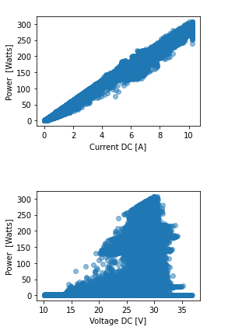
Data
Yearly data for both the solar cell farm and weather station data is provided
2014, 2015, 2016
Current & Voltage will be discounted from the model as we know current*voltage = Power

Slide 5
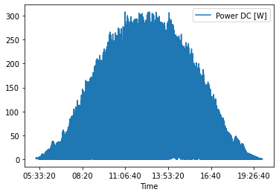
Data Analysis

Slide 8
Model Results
The model performed extremely well
If computational cost is an issue, a linear regression model can be used in place of the more computationally intensive random forest best model.
On average, we were only off by 2.61 Watts of Power for every minute (row) of data.
MAE = 2.61
MSE = 19.68
R2 = 0.996

Slide 9
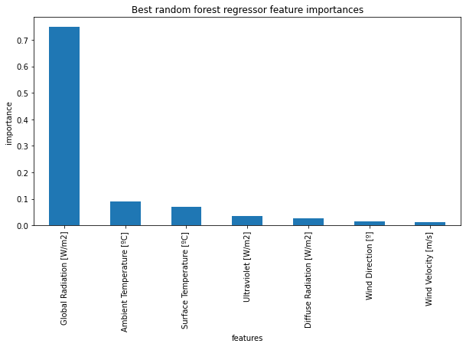
Feature Importance

Slide 10
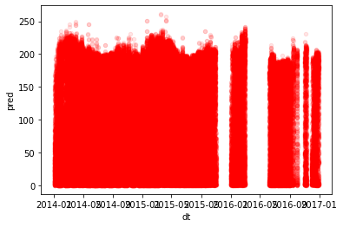
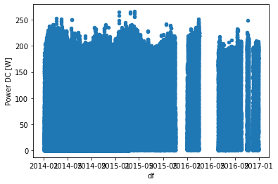
Predictions

Slide 11
Future work
While out of the scope of this POC, time series analysis can be completed to better understand the seasonality of the data
To increase data, more weather data should be sourced, including cloud cover.
When new PV Cells are put in place, the model should be retrained to account for any differences in materials used due to technological advances.

